Slide 1
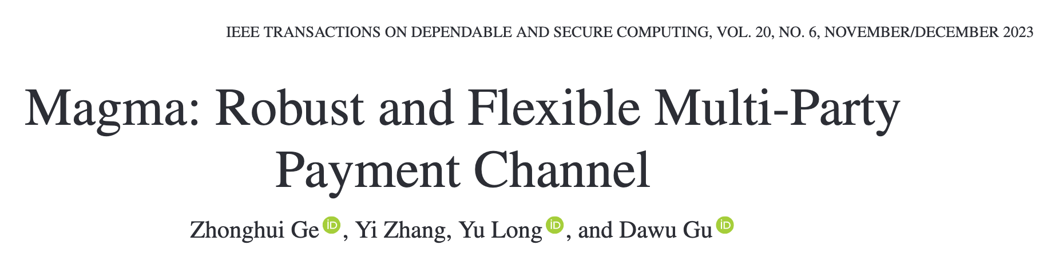
赵路路
2024.10.11

Slide 2
Contents
Abstract
Roadmap & Motivation
Magma Architecture & Security Model
Ideal Functionality & Real Protocol
UC Security Analysis
Experiment & Conclusion

Slide 3
Contents
Abstract
Roadmap & Motivation
Magma Architecture & Security Model
Ideal Functionality & Real Protocol
UC Security Analysis
Experiment & Conclusion

Slide 4
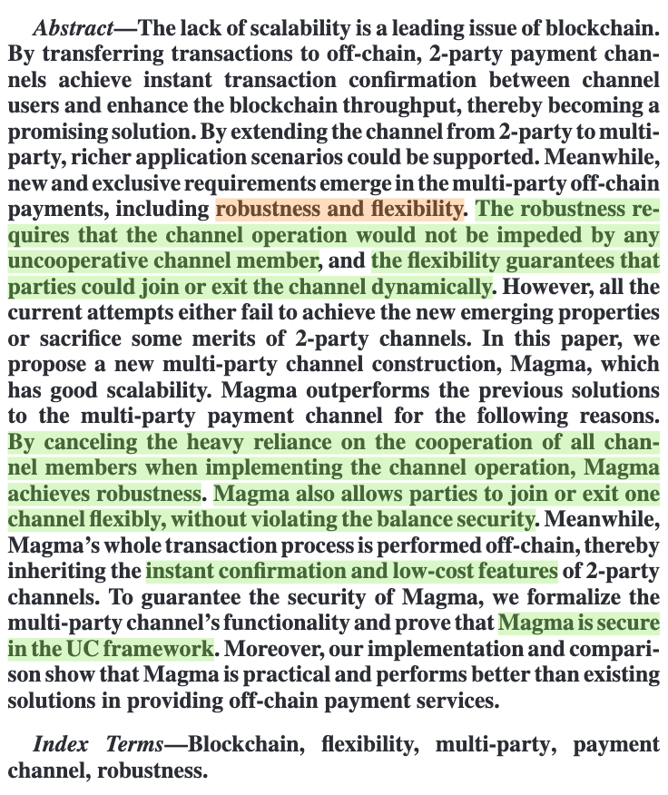
Abstract

Slide 5
Contents
Abstract
Roadmap & Motivation
Magma Architecture & Security Model
Ideal Functionality & Real Protocol
UC Security Analysis
Experiment & Conclusion

Slide 6
Roadmap & Motivation
Blockchain scalability, characterized by transaction throughput and confirmation latency.
Payment channel, known as “off-chain” techniques, is instantly confirmed.
Optimization of PC: privacy preserving & PCN.

Slide 7
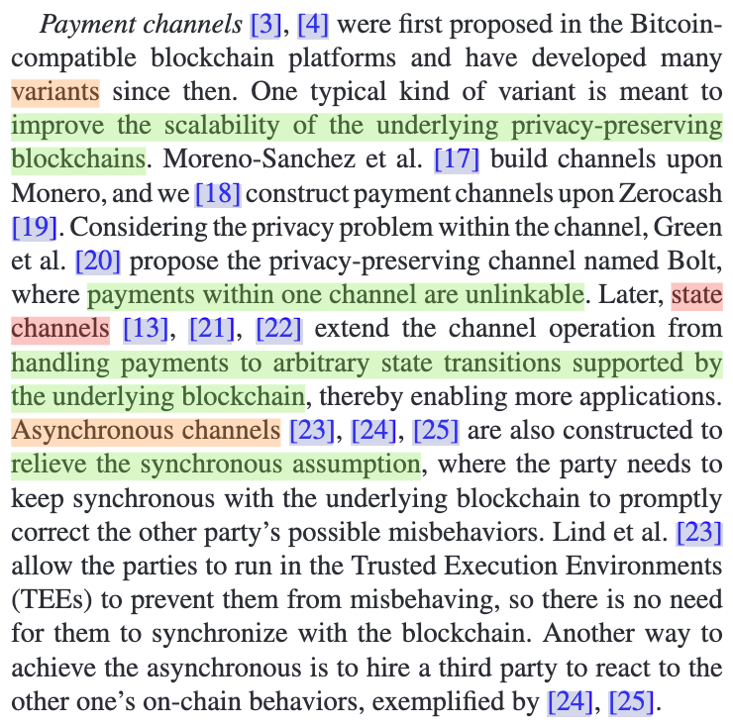
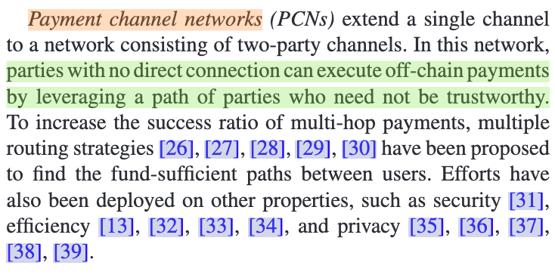
Roadmap & Motivation

Slide 8
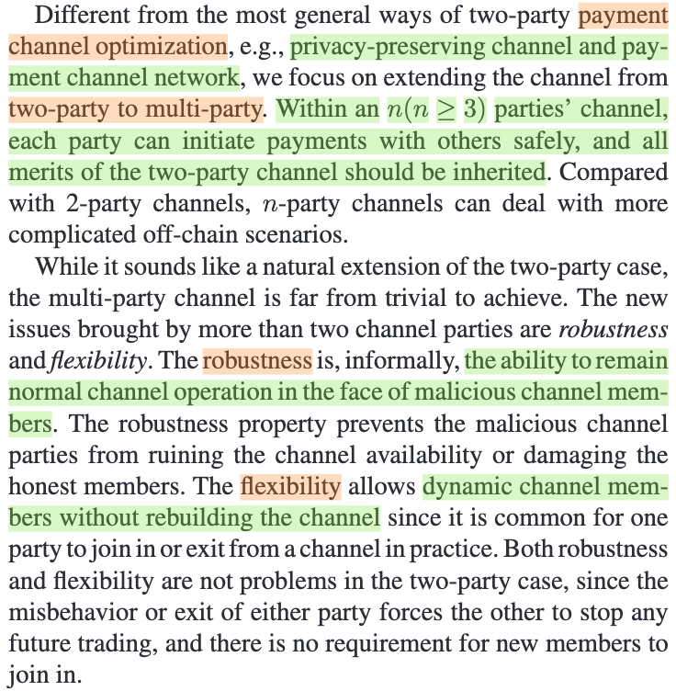
Roadmap & Motivation
Extending the channel from two-party to multi-party.

Slide 9
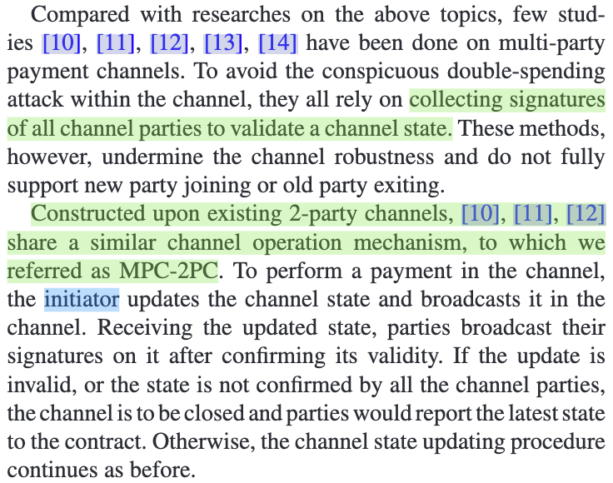
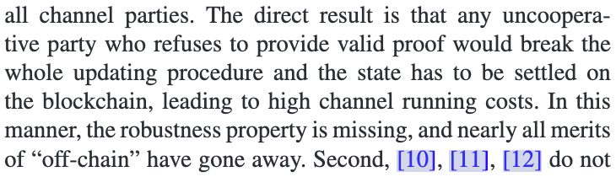
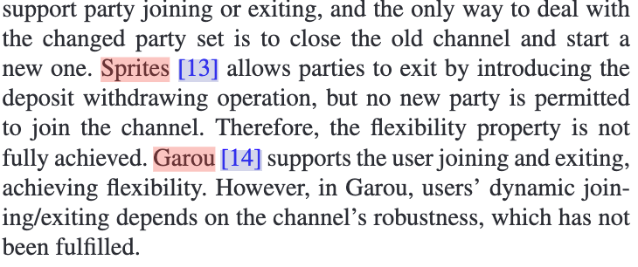
Roadmap & Motivation
Shortcomings of existing multi-party channels.

Slide 10
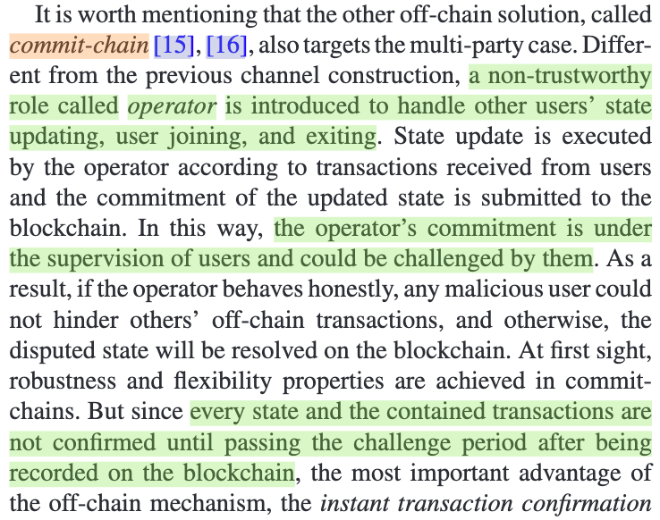
Roadmap & Motivation
Commit chains.
NOCUST
NOCUST-ZKP
Plasma
Plasma Cash
Plasma MVP
ZK-Rollup

Slide 11
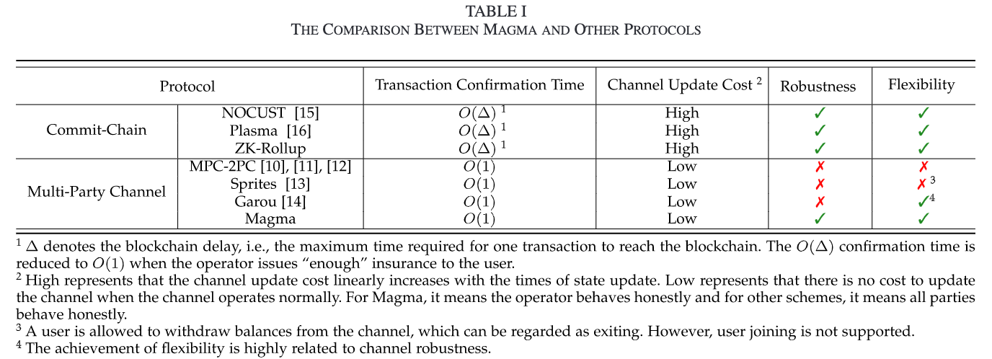
Roadmap & Motivation
Motivation.

Slide 12
Contents
Abstract
Roadmap & Motivation
Magma Architecture & Security Model
Ideal Functionality & Real Protocol
UC Security Analysis
Experiment & Conclusion

Slide 13
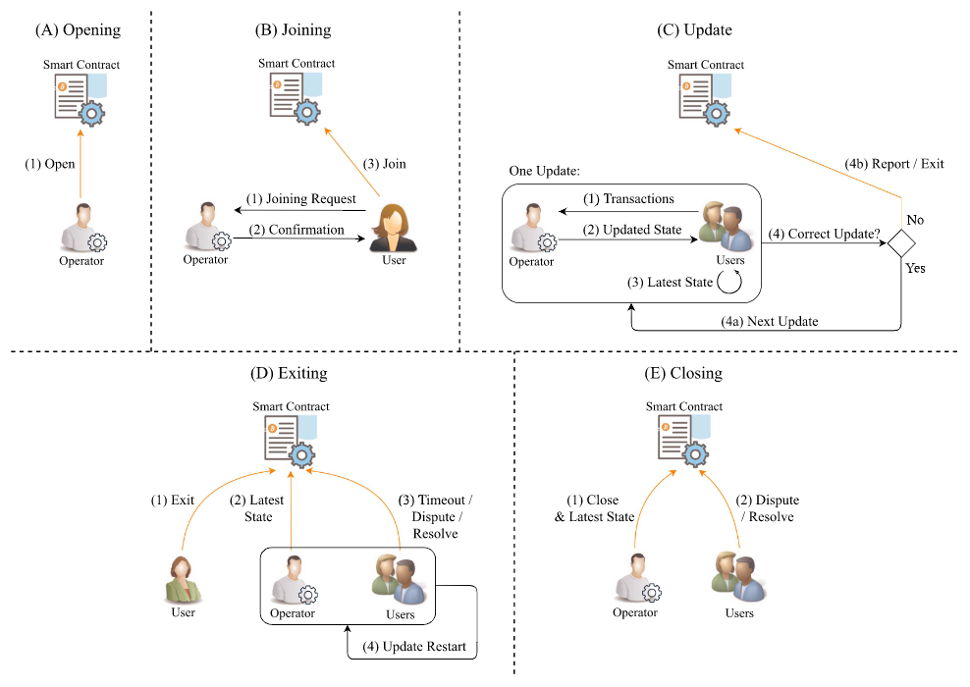
Magma Architecture & Security Model
Roles
Smart contract
Operator
User
Procedures
Opening
Joining
Update
Exiting
Closing

Slide 14
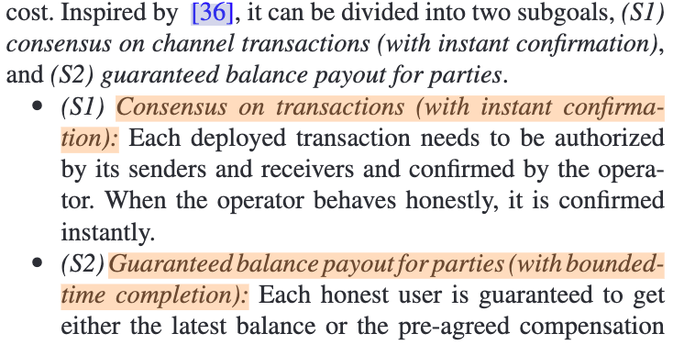
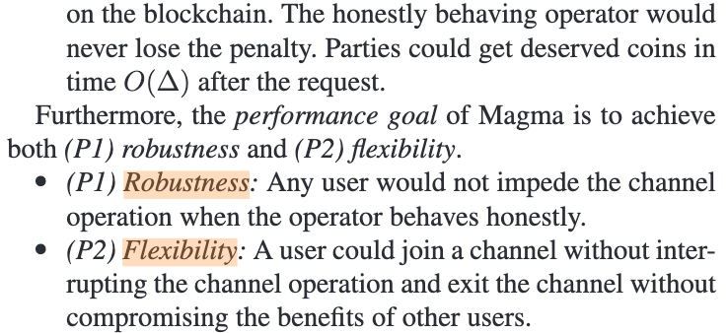
Magma Architecture & Security Model
Security and performance goals.

Slide 15
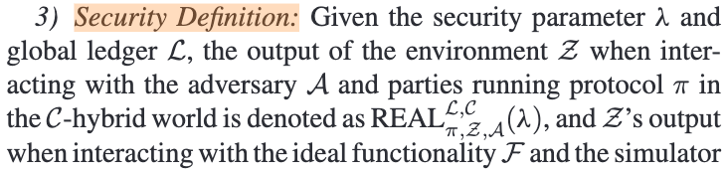
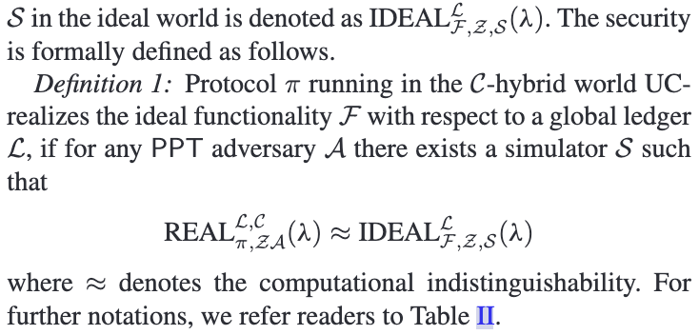
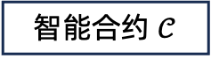






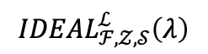
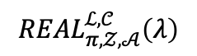



Magma Architecture & Security Model
Global UC framework.
$$REAL_{π,𝒵,𝒜}^{ℒ,𝒞}\left(λ\right)$$
$$IDEAL_{ℱ,𝒵,𝒮}^{ℒ}\left(λ\right)$$
环境 $𝒵$
环境 $𝒵$
区块链 $ℒ$
$$\sim$$
理想功能 $ℱ$
智能合约 $𝒞$
$$𝒫$$
$$𝒜$$
$$𝒫$$
$$𝒮$$
真实世界
理想世界

Slide 16
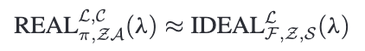
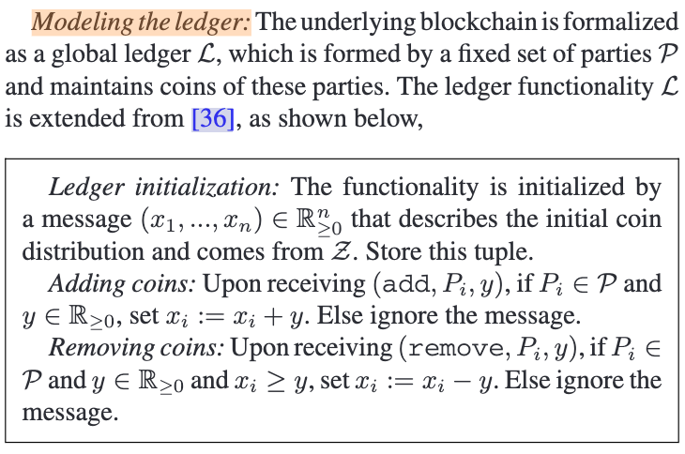
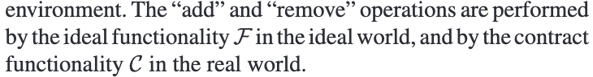
Magma Architecture & Security Model
Modeling the ledger.

Slide 17
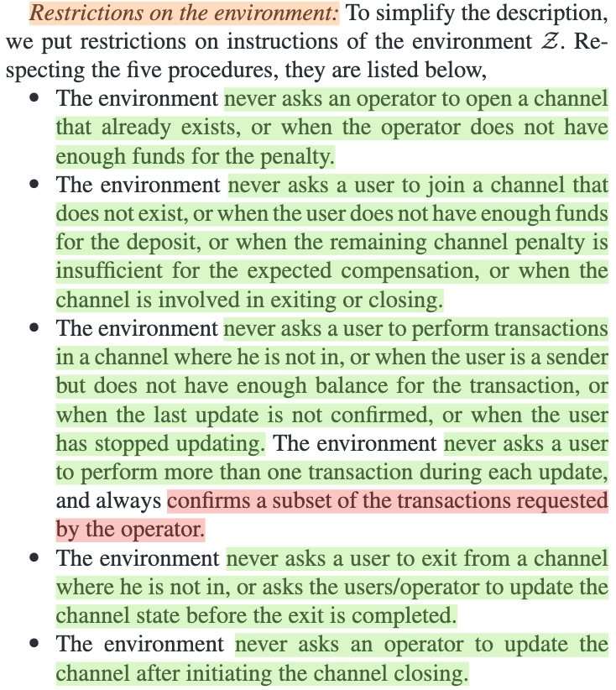
Magma Architecture & Security Model
Restrictions on the environment.

Slide 18
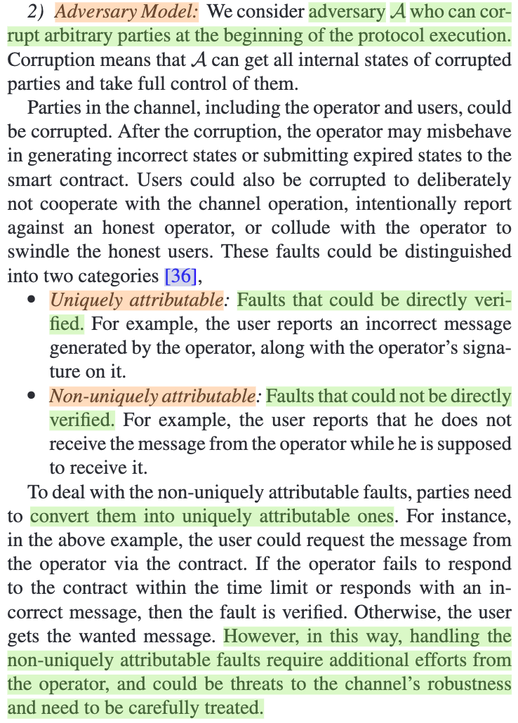
Magma Architecture & Security Model
Modeling the adversary.

Slide 19
Contents
Abstract
Roadmap & Motivation
Magma Architecture & Security Model
Ideal Functionality & Real Protocol
UC Security Analysis
Experiment & Conclusion

Slide 20
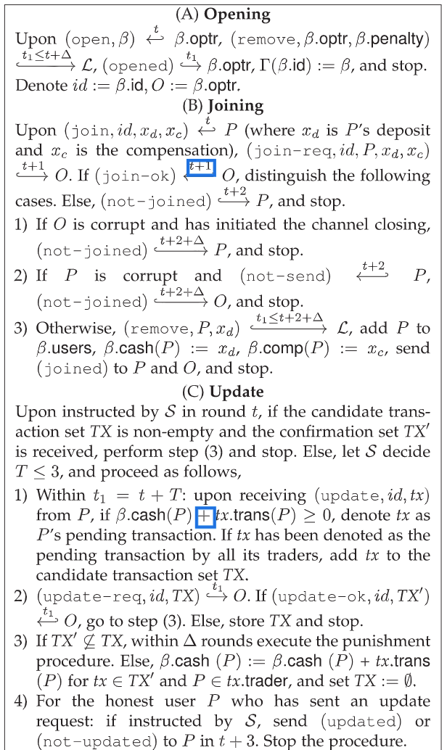
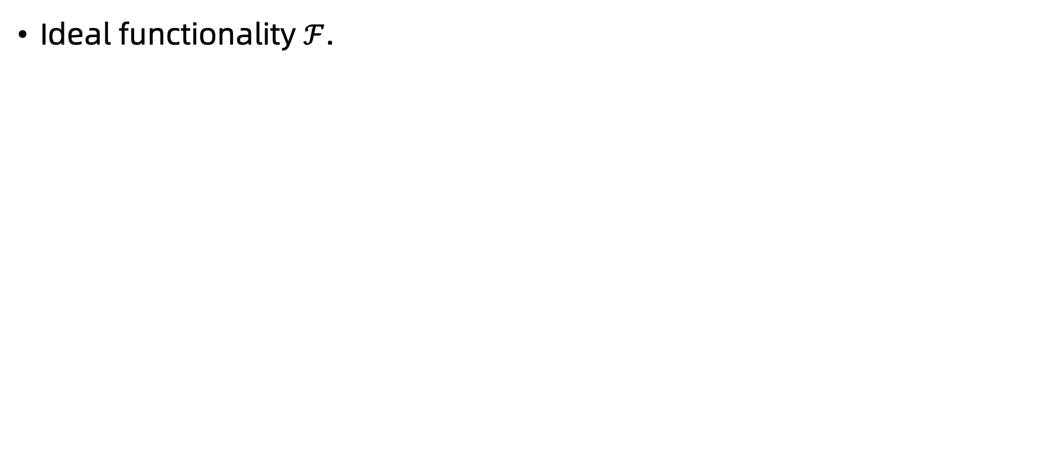
Ideal Functionality & Real Protocol
Ideal functionality $ℱ$.

Slide 21
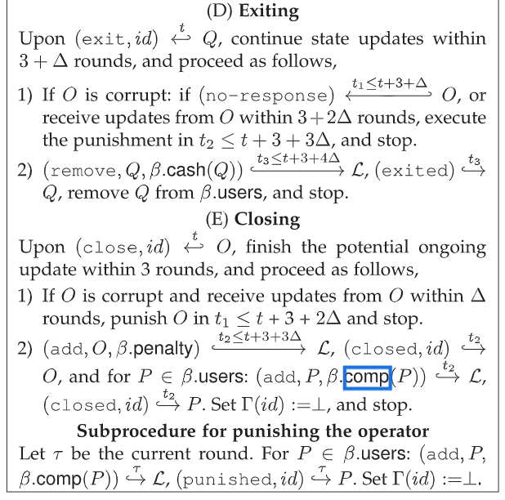
Ideal Functionality & Real Protocol
Ideal functionality $ℱ$.

Slide 22
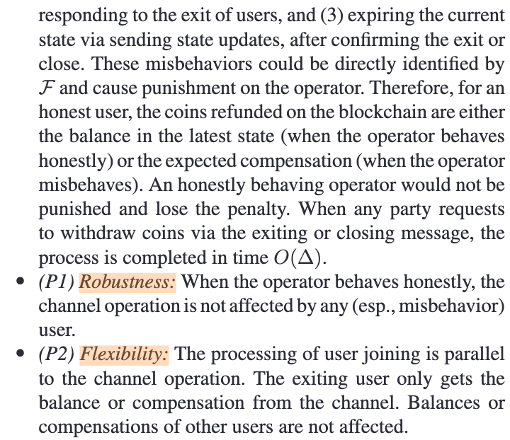
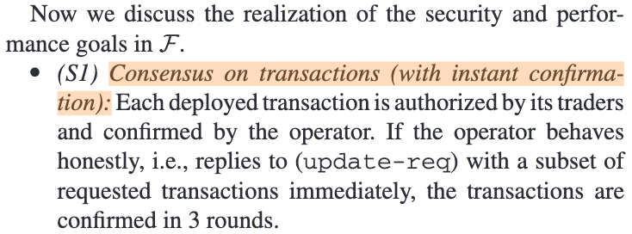
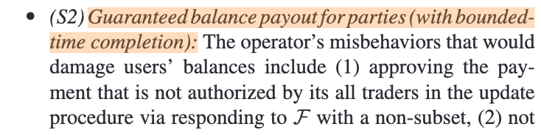
Ideal Functionality & Real Protocol
Ideal functionality $ℱ$.

Slide 23
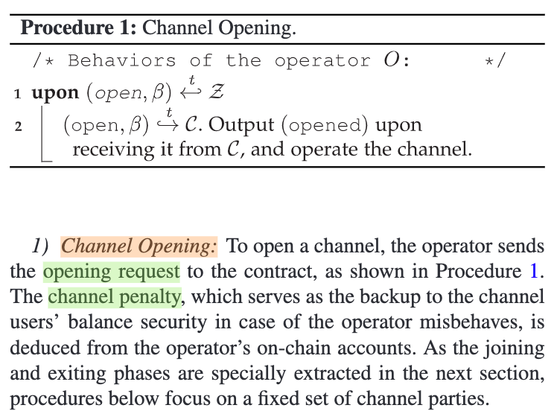
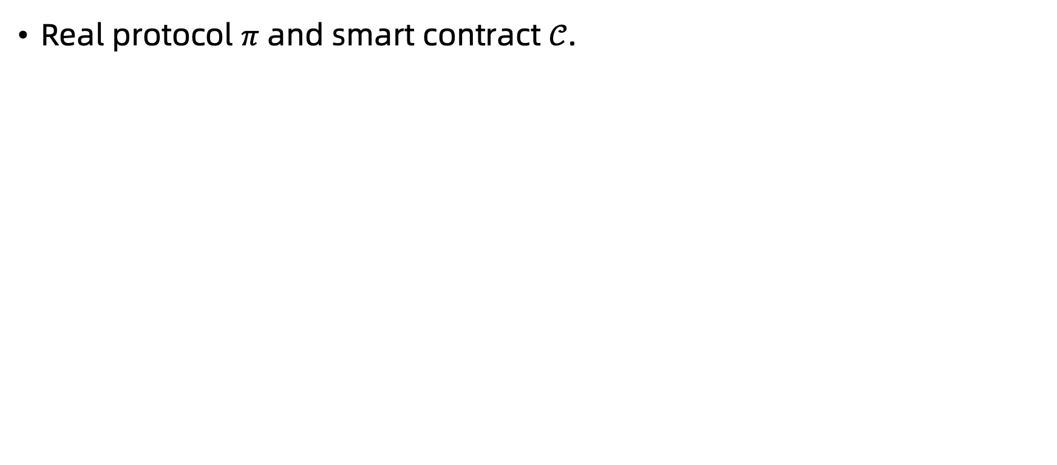
Ideal Functionality & Real Protocol
Real protocol $π$ and smart contract $𝒞$.

Slide 24
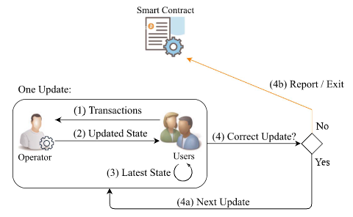
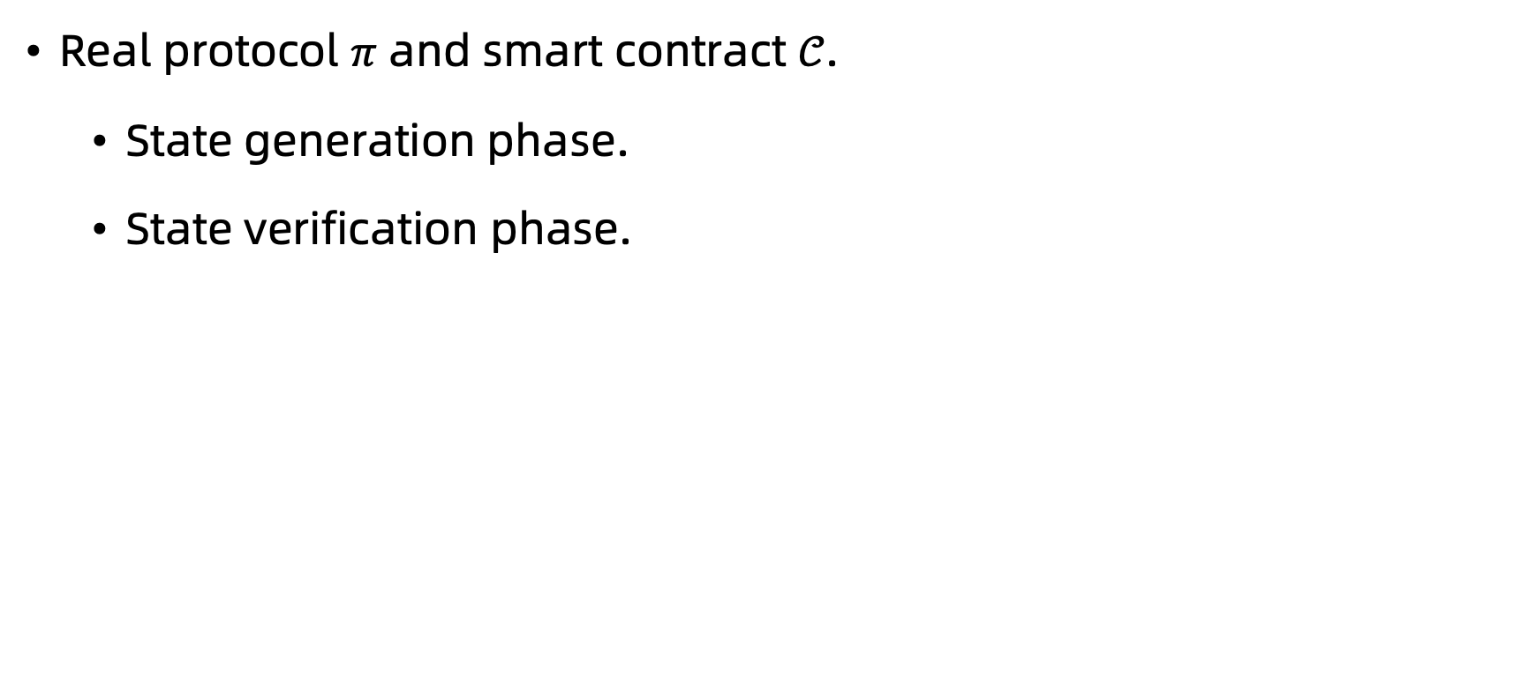
Ideal Functionality & Real Protocol
Real protocol $π$ and smart contract $𝒞$.
State generation phase.
State verification phase.

Slide 25
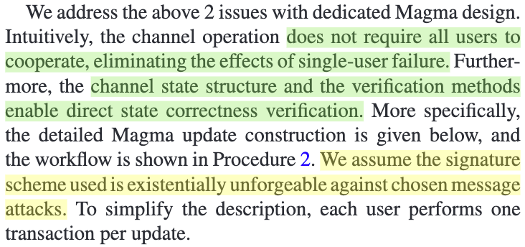
Ideal Functionality & Real Protocol
Real protocol $π$ and smart contract $𝒞$.
新状态中有非法行为
操作员发送不相同的状态
唯一归因
更新操作中的鲁棒性威胁
序列号不连续
单用户故障
非唯一归因

Slide 26
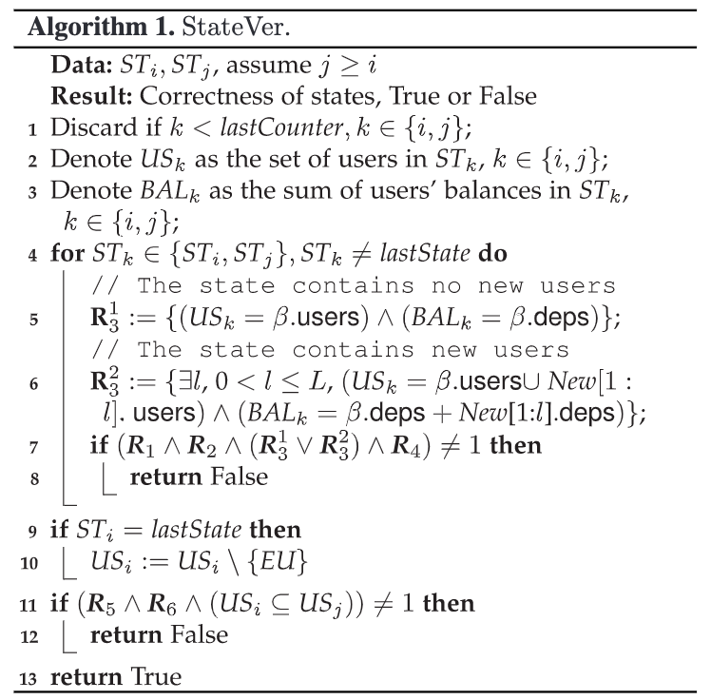
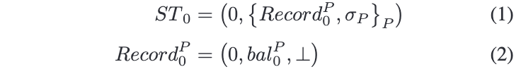
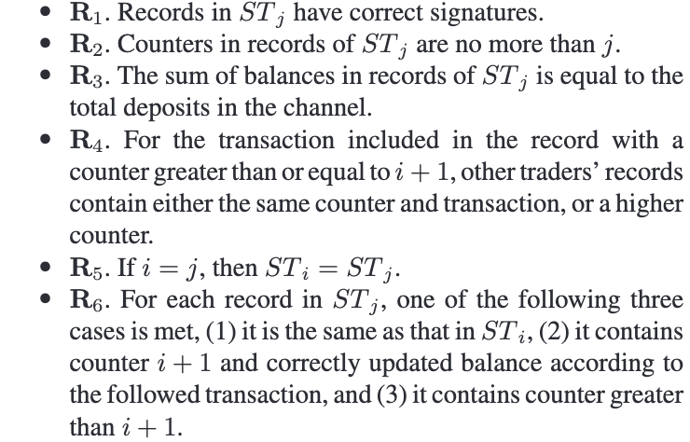
Ideal Functionality & Real Protocol
Real protocol $π$ and smart contract $𝒞$.

Slide 27
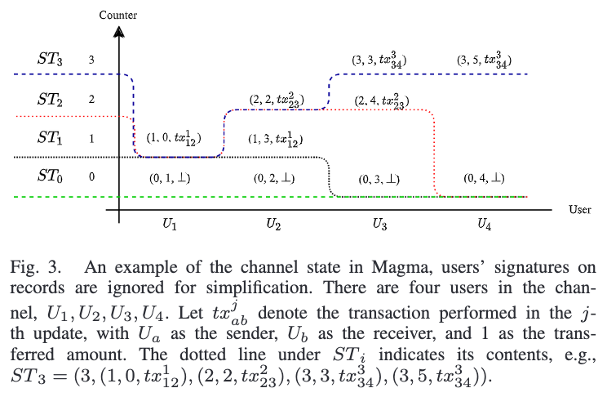
Ideal Functionality & Real Protocol
Real protocol $π$ and smart contract $𝒞$.

Slide 28
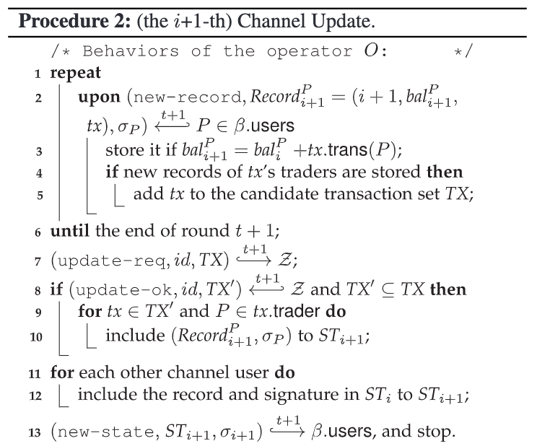
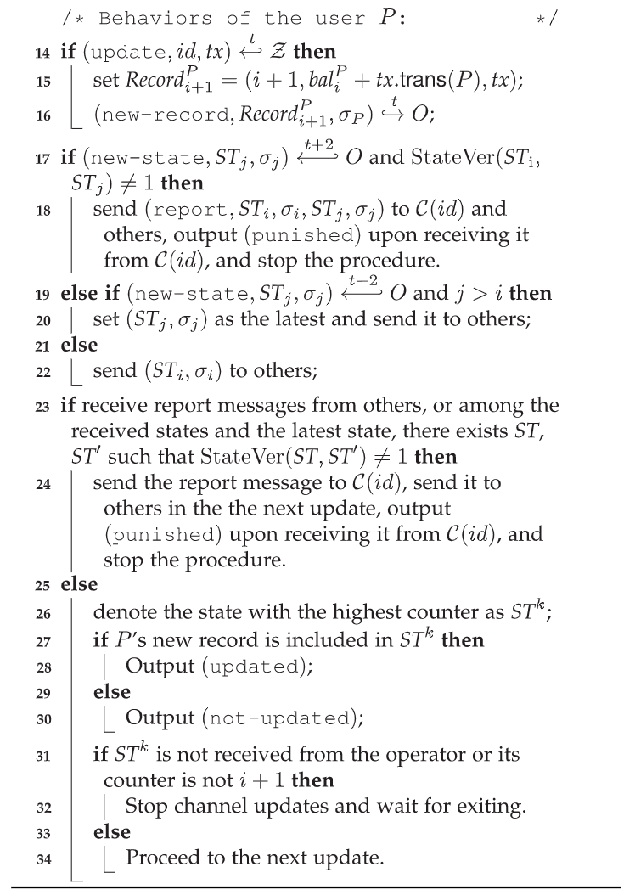
Ideal Functionality & Real Protocol
Real protocol $π$ and smart contract $𝒞$.

Slide 29
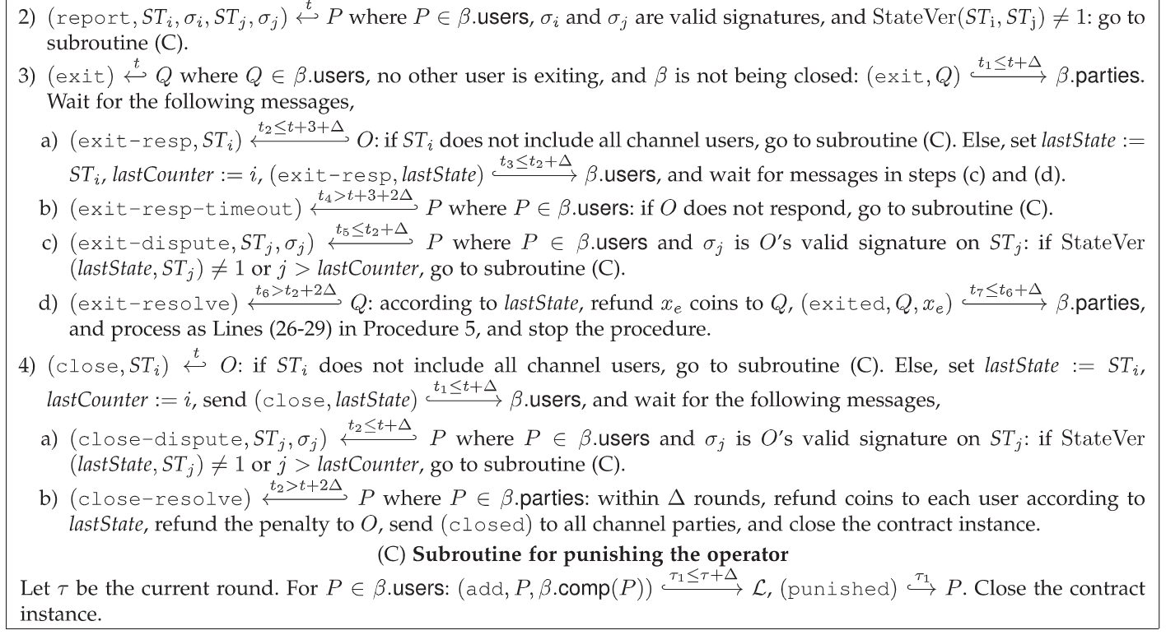
Ideal Functionality & Real Protocol
Real protocol $π$ and smart contract $𝒞$.

Slide 30
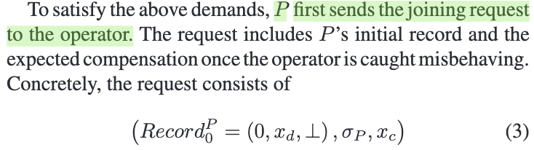
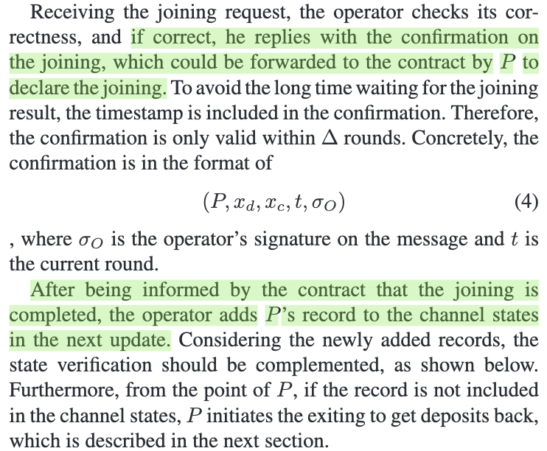
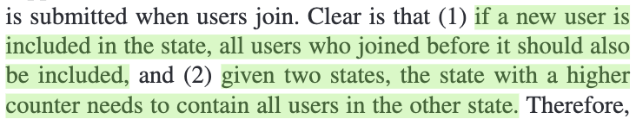
Ideal Functionality & Real Protocol
Real protocol $π$ and smart contract $𝒞$.
需要回顾StateVer过程

Slide 31
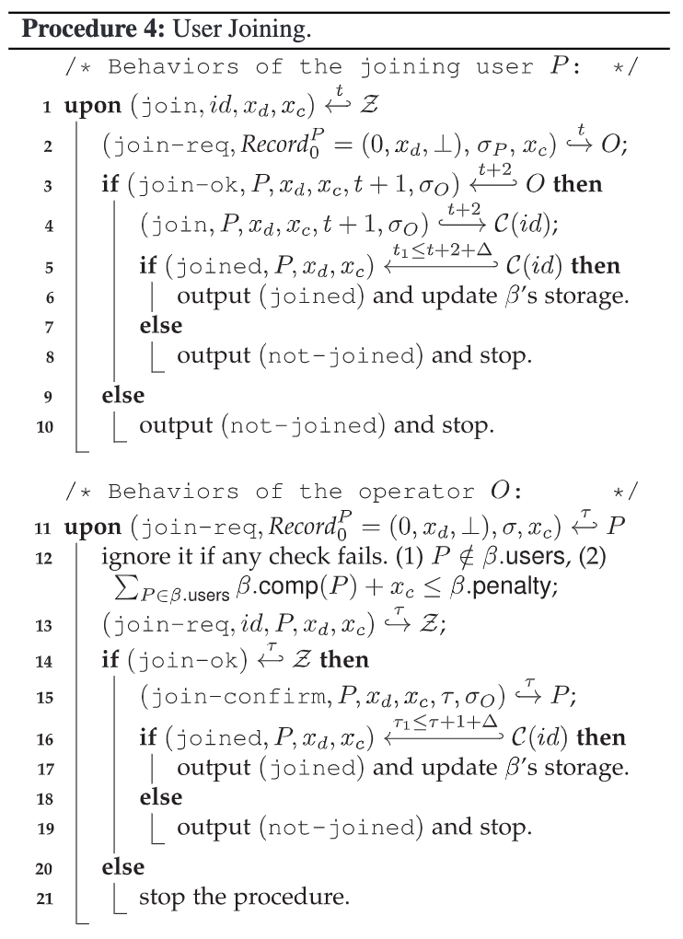
Ideal Functionality & Real Protocol
Real protocol $π$ and smart contract $𝒞$.

Slide 32
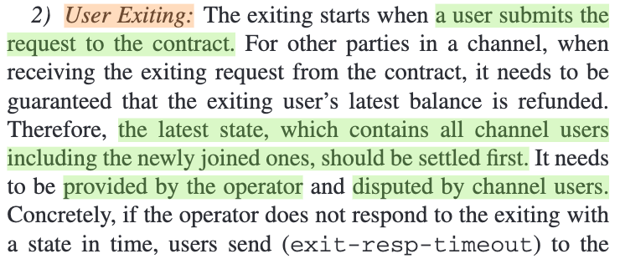
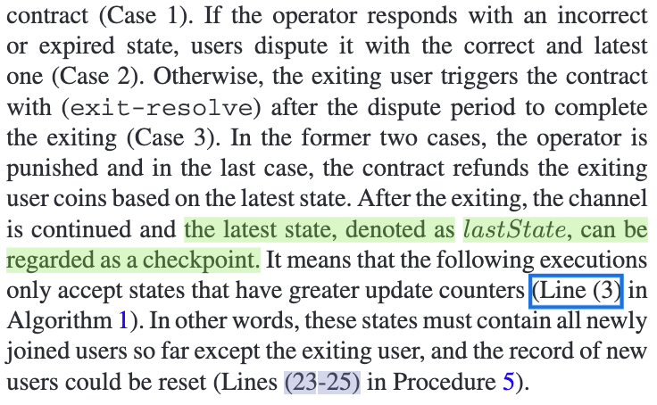
Ideal Functionality & Real Protocol
Real protocol $π$ and smart contract $𝒞$.

Slide 33
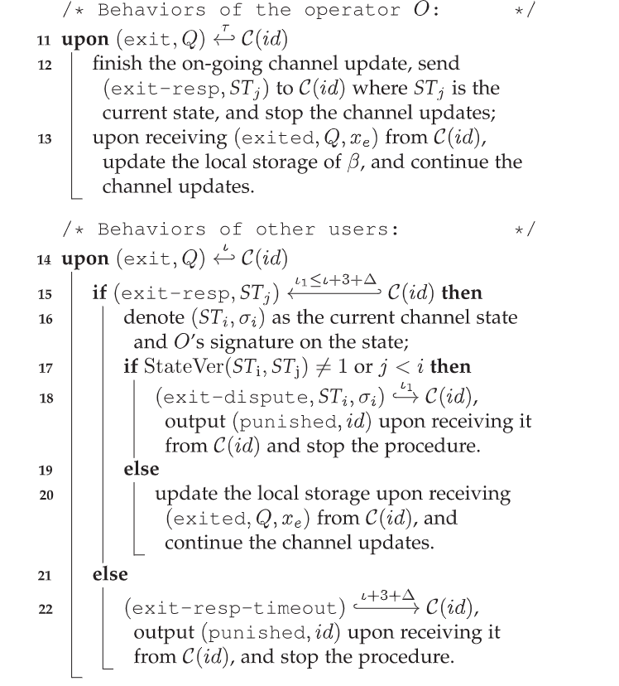
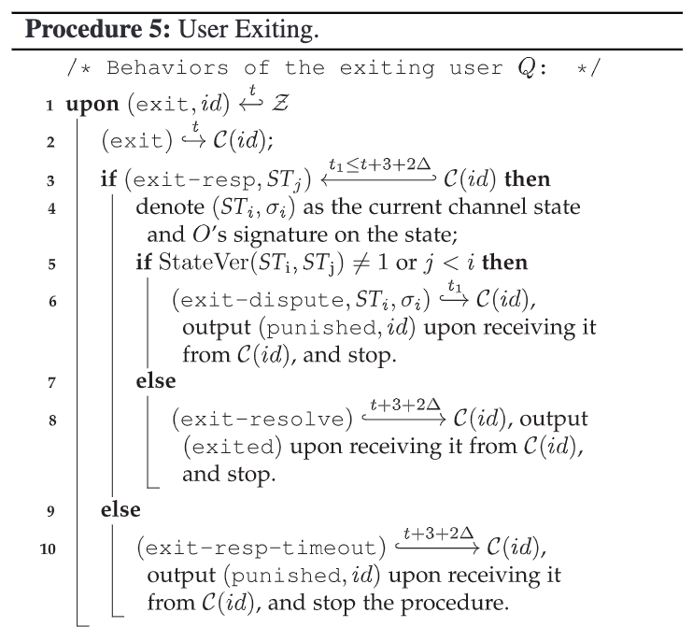
Ideal Functionality & Real Protocol
Real protocol $π$ and smart contract $𝒞$.

Slide 34
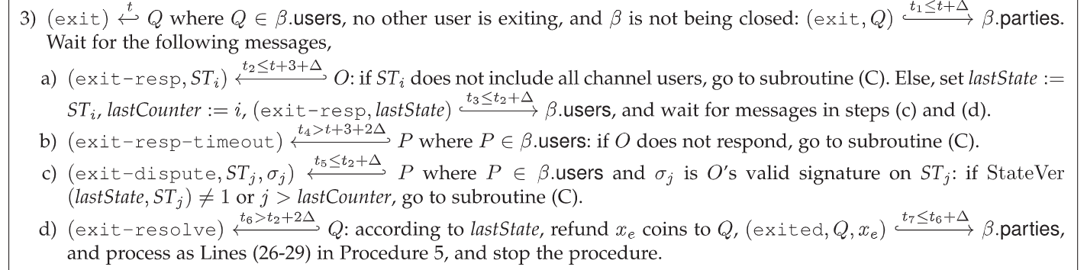
Ideal Functionality & Real Protocol
Real protocol $π$ and smart contract $𝒞$.

Slide 35


Ideal Functionality & Real Protocol
Real protocol $π$ and smart contract $𝒞$.

Slide 36
Contents
Abstract
Roadmap & Motivation
Magma Architecture & Security Model
Ideal Functionality & Real Protocol
UC Security Analysis
Experiment & Conclusion

Slide 37

UC Security Analysis
If Magma is indistinguishable from the ideal functionality with the ideal functionality’s achievement of desired goals, we derive that Magma also achieves the goals.

Slide 38
Contents
Abstract
Roadmap & Motivation
Magma Architecture & Security Model
Ideal Functionality & Real Protocol
UC Security Analysis
Experiment & Conclusion

Slide 39

Experiment & Conclusion

Slide 40
Thanks! Questions?
Notes:
1、隐私问题，恶意用户加入通道观察交易流向？
2、不参与交易的用户需要时刻在线监督操作员的行为，缺乏实用性？

